Slide 1

IVERMECTINA Y CARRAGENINA EN LA TERAPIA DE COVID 19
PROF. DR. HÉCTOR E. CARVALLO
PROF. DR. ROBERTO R. HIRSCH

Slide 2
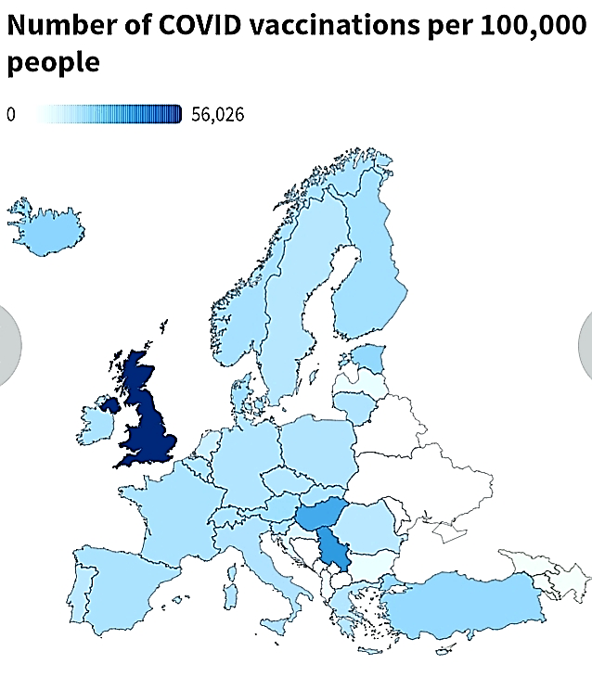
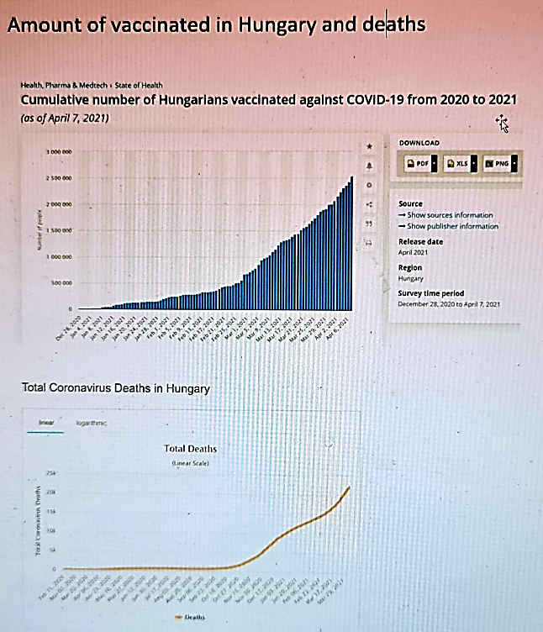
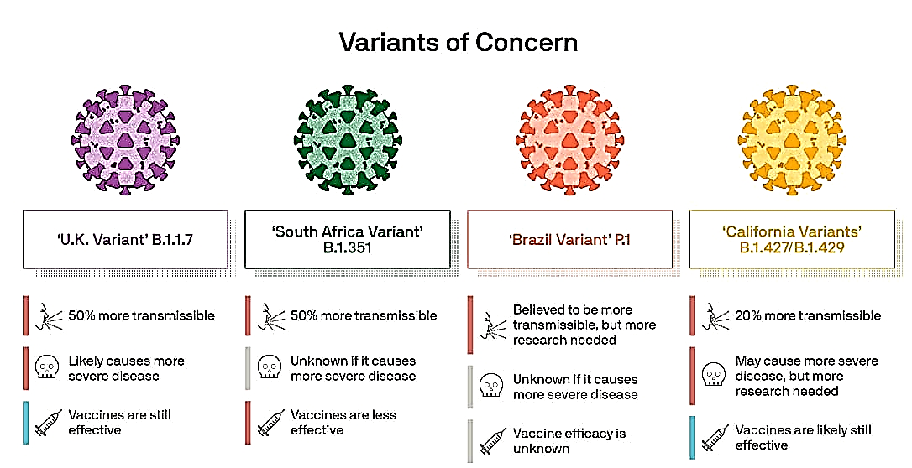
SÓLO LOS HECHOS

Slide 3

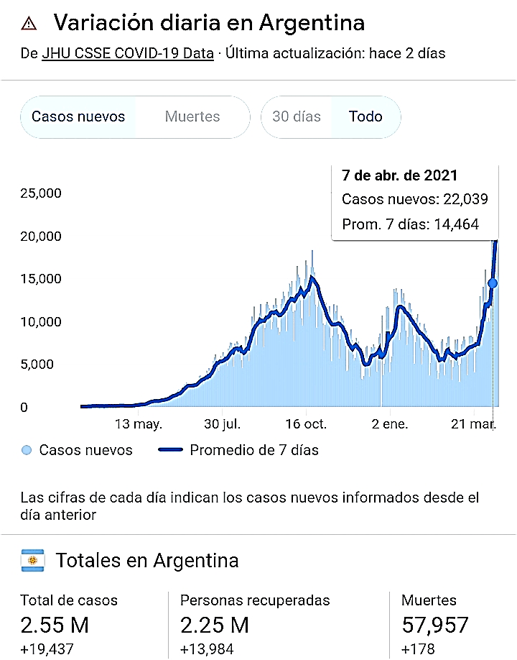
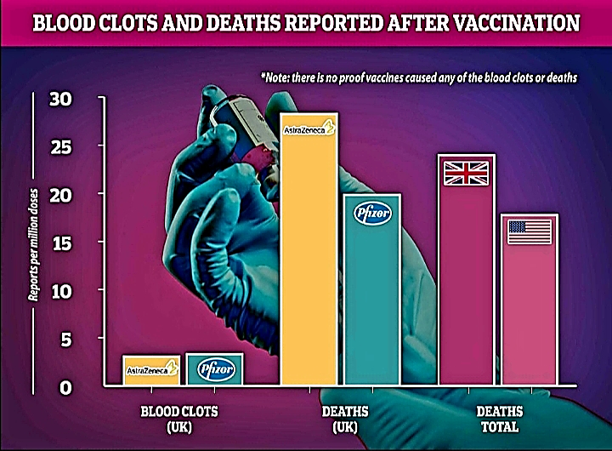

Slide 4
Efectos del virus sobre el organismo (patogénesis)
Efectos del virus sobre otros individuos (contagio)

Slide 5
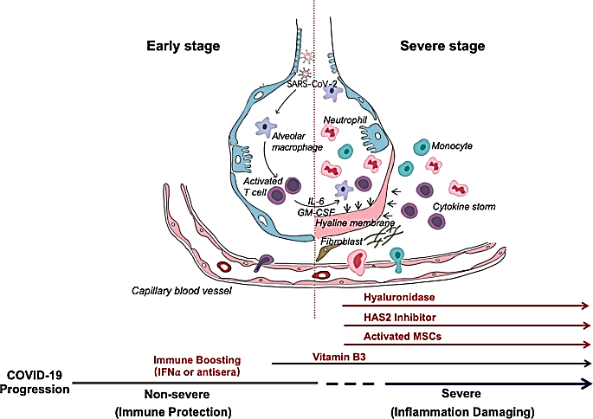

Slide 6
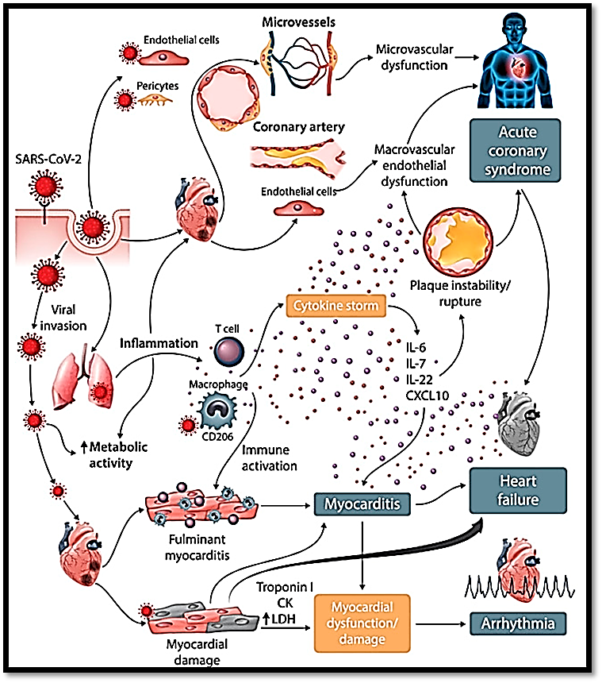

Slide 7
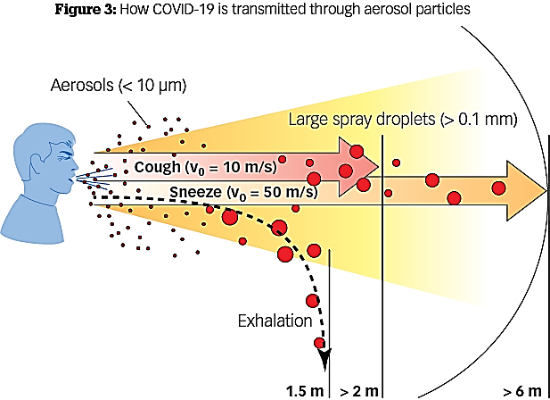

Slide 8
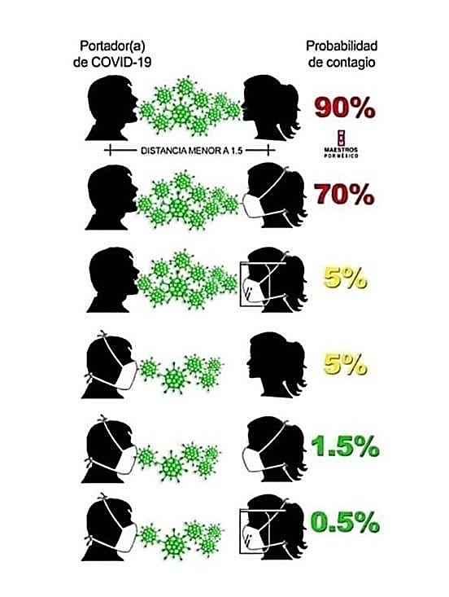

Slide 9
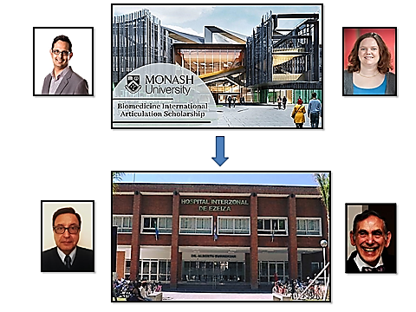
IVERMECTINA , DE AUSTRALIA A ARGENTINA

Slide 10
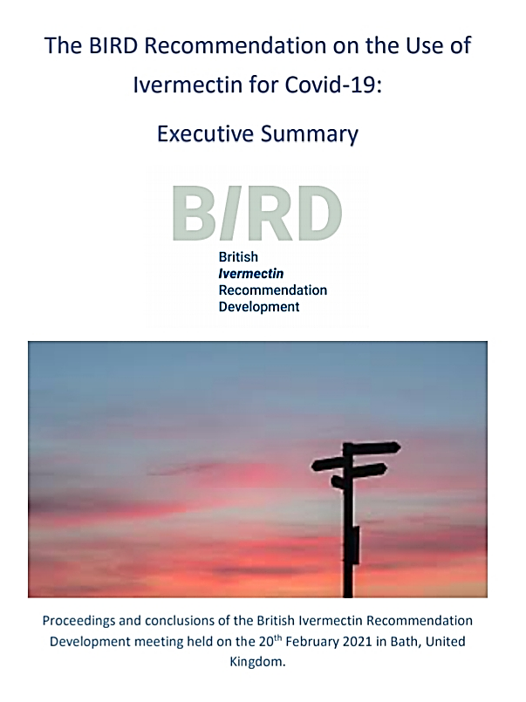
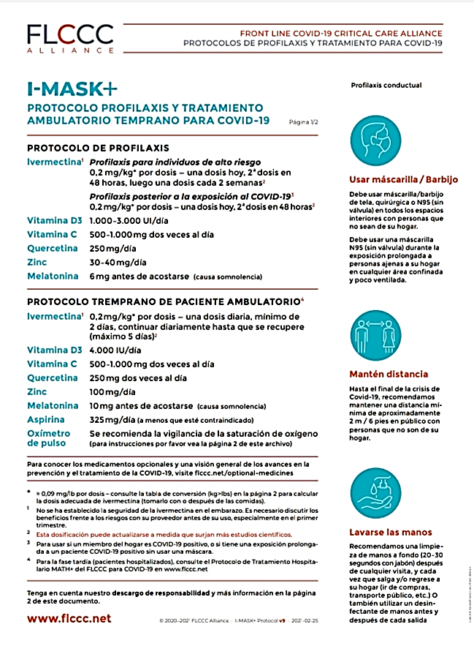
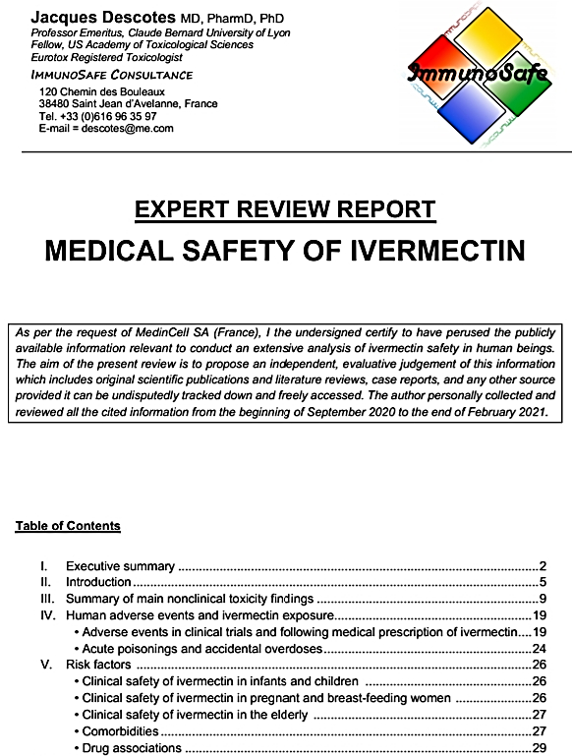
ORGANIZACIONES INTERNACIONALES QUE TRABAJAN CON IVM

Slide 11
IVERMECTIN
PROPHYLAXIS TREATMENT
ALONE + CARRAGEENAN I.D.E.A.
IVER.PREV IVER.CAR

Slide 12
IVERMECTIN MECHANISMS OF ACTION
EXTRACELLULAR IONONOPHORES
DIRECT
INTRACELLULAR ALFA/BETA 1 IMP. BLOCKAGE
INMUNE MODULATION (INTERFERENCE Il6/IL10)
INDIRECT ENDOTHELIUM STABILIZATION
PROTHROMBINE TIME PROLONGATION

Slide 13
CARRAGEENAN MECHANISMS OF ACTION
DIRECT opposite electric cargoes
INDIRECT competition for receptors

Slide 14
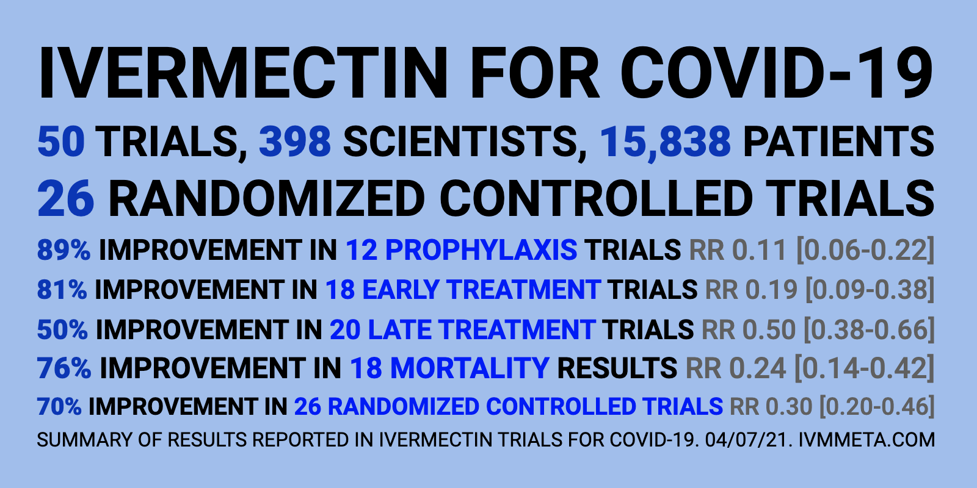
IVM META-ANÁLISIS
La probabilidad que un tratamiento ineficaz arroje resultados falsamente positivos, en los 50 trabajos examinados, es de 1 en 1 cuatrillón(p = 0,000000000000001)

Slide 15
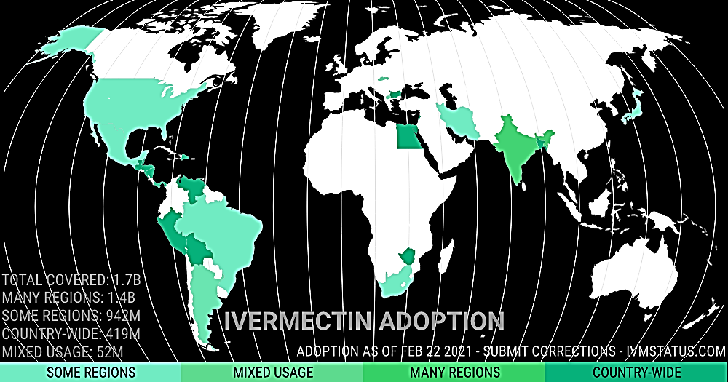
USO DE LA IVM CONTRA COVID EN EL MUNDO

Slide 16
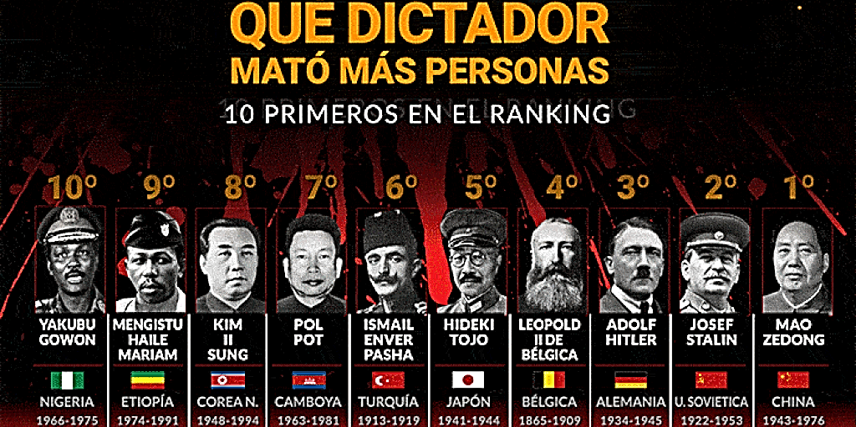
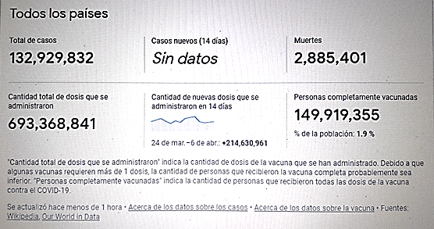
ESTAMOS AQUÍ

Slide 17
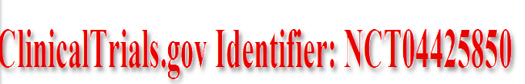
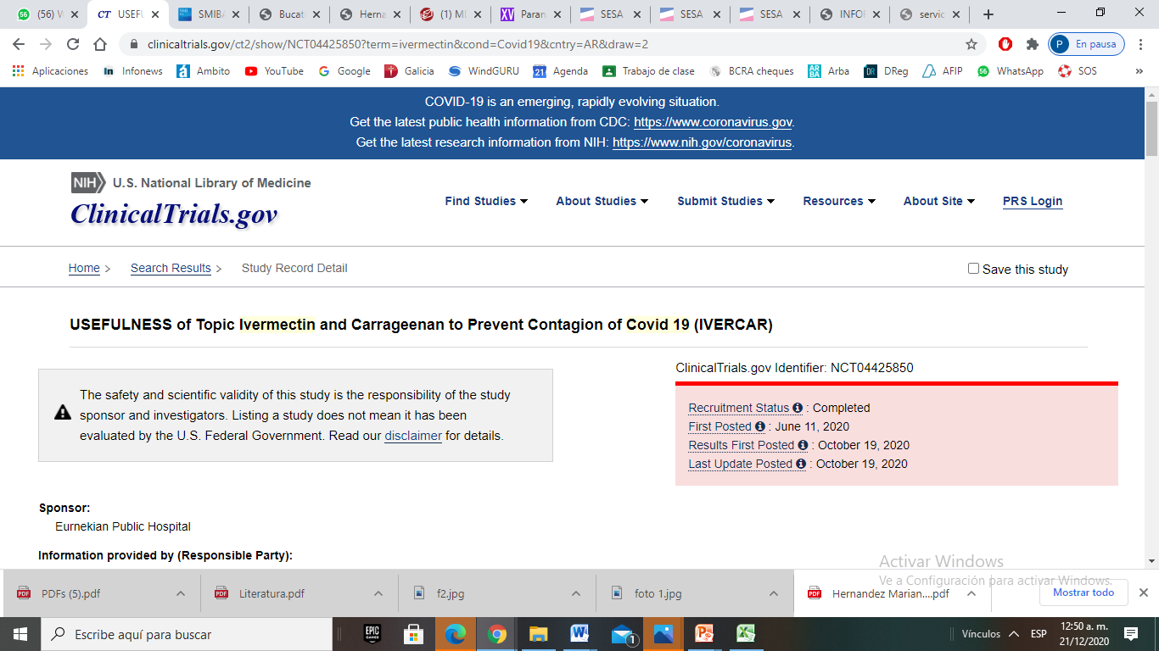

Slide 18
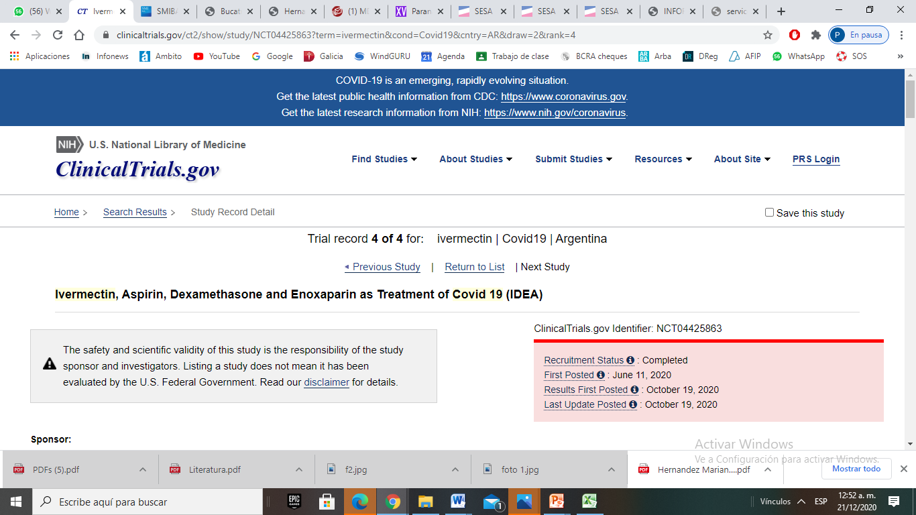

Slide 19
STUDY OF THE EFFICACY AND SAFETY OF TOPICAL IVERMECTIN + IOTACARRAGEENAN IN THE PROPHYLAXIS AGAINST COVID-19 IN HEALTH PERSONNEL
Journal of Biomedical Research and Clinical Investigation Volume 2 Issue 1.1007
DOI: https://doi.org/10.31546/2633-8653.1007
IVERMECTIN AS PROPHYLAXIS AGAINST COVID-19: RETROSPECTIVE CASES EVALUATION
Microbiology & Infectious Diseases
Citation: Hirsch RR, Carvallo, Héctor E. Ivermectin as Prophylaxis Against COVID-19 Retrospective Cases Evaluation. Microbiol Infect Dis. 2020; 4(4): 1-8.
COVID 19: CHILDREN SHOULD BE TREATED EVEN IN ABSENCE OF SYMPTOMS
Citation: Roberto RH, Héctor EC (2020) Covid 19: Children should be Treated Even in Absence of Symptoms. J Clin Toxicol. 10:457. DOI: 10.35248/2161-0495.20.10.457
Journal of Clinical Toxicology
SAFETY AND EFFICACY OF THE COMBINED USE OF IVERMECTIN, DEXAMETHASONE, ENOXAPARIN AND ASPIRINA AGAINST COVID-19: THE I.D.E.A. PROTOCOL
Citation: Hector C, Roberto H (2021) Safety and Efficacy of the Combined Use of Ivermectin, Dexamethasone, Enoxaparin and Aspirina against Covid-19 the I.D.E.A. Protocol.
J Clin Trials. 11:459.
Journal of Clinical Trials, Vol.11 Iss.3 No:1000459
COVID 19 AND IVERMECTIN PREVENTION AND TREATMENT UPDATE
Journal of Infectious Diseases & Travel Medicine Conceptual Paper Volume 4 Issue 2 DOI: 10.23880/jidtm-16000144
J Inf Dis Trav Med
BROMHEXINA. UN PASO MÁS EN LA ESTRATEGIA TERAPÉUTICA CONTRA COVID-19
Archivos de Alergia e Inmunología Clínica 2020;51(3):117-124

Slide 20
IVERMECTIN IN COVID-19 PATIENTS A MULTICENTER: RETROSPECTIVE STUDY
Journal of Infectious Diseases & Therapy Volume 9 Issue S1 S1005
J Infect Dis Ther 2020, 9:S1
IVERMECTIN AND HERD IMMUNITY IN SARS COV2 PANDEMIC FROM LOCAL EXPERIENCE TO BROADER POSSIBILITY
Clinical Immunology & Research
Citation: Hector E Carvallo, Roberto R Hirsch. Ivermectin and Herd Immunity in SARS COV2 Pandemic from Local Experience to Broader Possibility.
Clin Immunol Res. 2020; 4(1): 1-2.
IVERMECTIN IN LONG-COVID PATIENTS: A RETROSPECTIVE STUDY Journal of Biomedical Research and Clinical Investigation Volume 2 Issue 1.1008
DOI: https://doi.org/10.31546/2633-8653.1008
COVID-19 AND REPURPOSED DRUGS: HOW MUCH IS A HUMAN LIFE?
Clinical Immunology & Research
Citation: Hector CE, Francesco M, Roberto HR. COVID-19 and Repurposed Drugs How Much is A Human Life? Clin Immunol Res. 2021; 5(1): 1-11.
SARS COV2, EMERGING, REEMERGING AND POTENTIALLY EMERGING DISEASES IN ARGENTINA
Journal of Virology and Infectious Diseases
J Virol Infect Dis. (2021) Volume 2 Issue 1 Pages 13-17
Citation: Roberto RH, Héctor CE. (2021) SARS COV2, Emerging, Reemerging and Potentially Emerging Diseases in Argentina. J Virol Infect Dis. 2021;2(1):13-17.
IVERMECTIN AND SARS COV 2 PANDEMIC: THE RIGHT TIME TO START
Journal of Current Emergency Medicine Reports
Citation: Carvallo HE and Hirsch RR. Ivermectin and Sars Cov 2 Pandemic: The Right Time to Start. Journal of Current Emergency Medicine Reports. 2021;1(1):1-6.

Slide 21
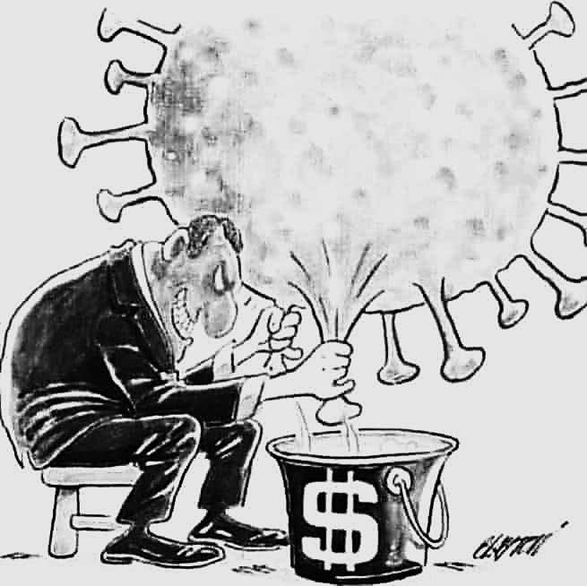
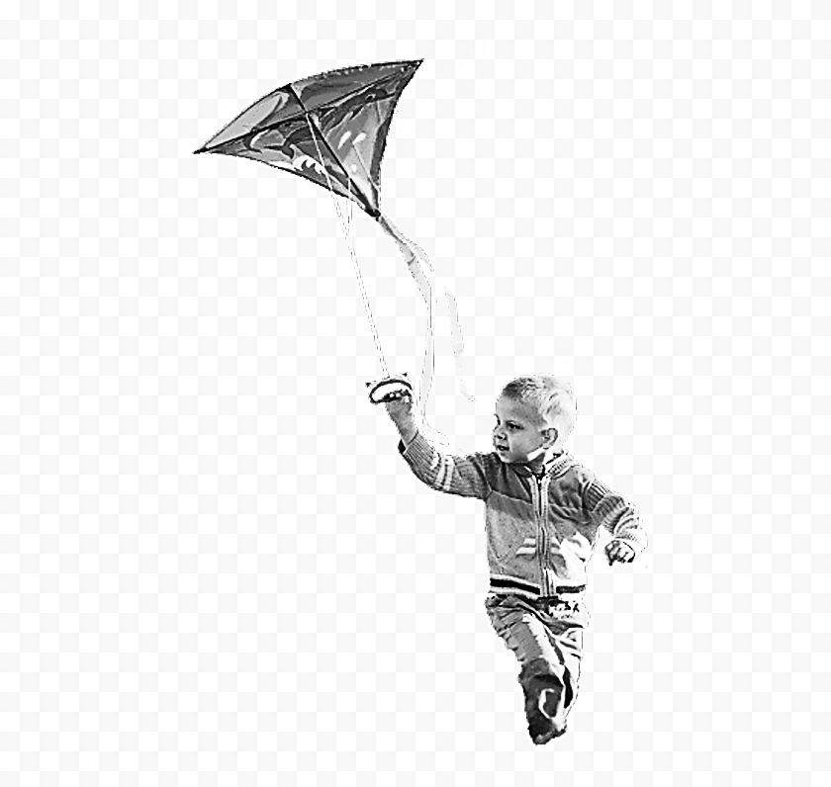
CONCLUSIONES

Slide 22

GRACIAS

